Slide 1

Review: Unsteady State
Nonisothermal Reactor Design
Goal: develop EB for unsteady state reactor
δQ
F_{in}
F_{out}
An open system (for example, CSTR)
H_{in}
H_{out}
δW
Rate of accumulation of energy in system
rate of heat flow from surroundings to system
Rate of work done by system on surroundings
Rate of energy added to system by mass flow in
Rate of energy leaving system by mass flow out
=
-
+
-

Slide 2
Review: Simplified EB for Well-Mixed Reactors
Total Energy Balance for unsteady state
Made following substitutions & solved for dT/dt:
Constant PV variation
Energy balance for unsteady state reactor with phase change:
Energy balance for unsteady state reactor without phase change:

Slide 3
Review: Unsteady State EB,
Liquid-Phase Reactions
For liquid-phase reactions, often ΔC_{p} = Σν_{i}C_{pi} is so small it can be neglected
When ΔC_{p} can be neglected, then:
If the feed is well-mixed, it is convenient to use:
Plug these equations & T_{i0} = T₀ into the EB:
This equation for the EB is simultaneously solved with the mass balance (design eq) for unsteady state, nonisothermal reactor design

Slide 4
Review: Nonisothermal Batch
Reactor Design
0
No flow, so:
Put the energy balance in terms of conversion:
Solve with the batch reactor design equation using an ODE solver (Polymath):

Slide 5
Review: Adiabatic Nonisothermal Batch Reactor Design
0
0
For negligible stirring work:
Substitute:
Rearrange
Integrate & solve for X_{A}:
Solve for T:
Solve with the batch reactor design equation using an ODE solver (Polymath)

Slide 6
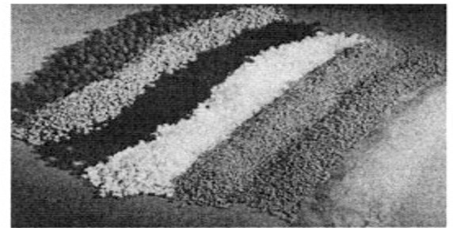
L17 Basic Catalysis & Reaction Mechanisms
Though we have discussed the use of catalyst in a PBR, we have not discussed the process of catalysis itself
An understanding of catalysis, the mechanisms, and catalytic reactor design are the subject of the next few lectures
  Catalyst properties
  Steps involved in a catalytic reaction
  Development of a rate law using steps in catalytic reaction
  Different types of catalyst mechanisms
  Design of catalytic reactors

Slide 7
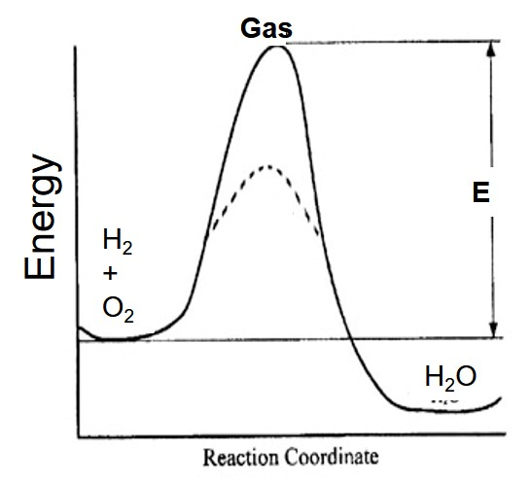
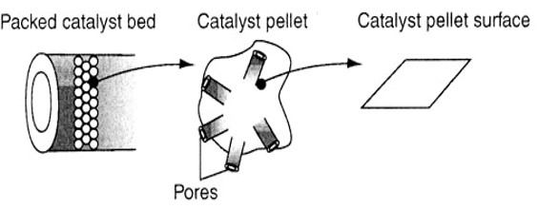
Catalysts & Catalysis
~1/3 of the GNP of materials produced in the US involve a catalytic process
A Catalyst is a substance that speeds up the rate of reaction but is not changed by the reaction
A catalyst lowers the energy barrier by promoting a different molecular pathway (mechanism) for the reaction
Homogeneous catalysis: catalyst is in solution with at least 1 reactant
Heterogeneous catalysis: more than 1 phase, usually solid and fluid or solid and gas is present. Reaction occurs at solid/liquid or gas interface.
Many catalyst are porous (high surface area)
catalyst

Slide 8
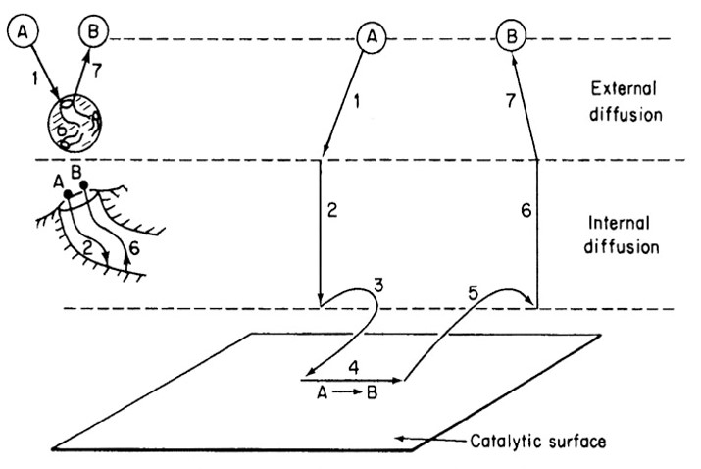
Steps in a Heterogeneous Catalytic Reaction
7. Diffusion of B from external surface to the bulk fluid (external diffusion)
1. Mass transfer of A to surface
2. Diffusion of A from pore mouth to internal catalytic surface
6. Diffusion of B from pellet interior to pore mouth
3. Adsorption of A onto catalytic surface
5. Desorption of product B from surface
4. Reaction on surface
Ch 10 assumes steps 1,2,6 & 7 are fast, so only steps 3, 4, and 5 need to be considered

Slide 9
Adsorption Step
The adsorption of A (gas phase) on an active site S is represented by:
A
-S-S-S-
A(g) + S ⇌ A·S
A
I
-S-S-S-
S: open (vacant) surface site A·S: A bound to a surface site
Rate of adsorption = rate of attachment – rate of detachment
Conc of sites occupied by A
partial pressure of A
Molar conc of vacant sites on surface
Rate is proportional to # of collisions with surface, which is a function of P_{A}
Rate is proportional to # of vacant (active) sites, C_{v}, on the surface
Active site: site on surface that can form a strong bond with adsorbed species
In terms of the adsorption equilibrium constant K_{A} where
Equation I

Slide 10
Site Balance
C_{t}: Total number of active sites per unit mass of catalyst divided by Avogadro’s # (mol/g cat)
C_{v}: Number of vacant sites per unit mass of catalyst divided by Avogadro’s #
Active site occupied by A
Active site occupied by B
Vacant active site
A
B
Surface
C_{v} is not measurable, but the total number of sites C_{t} can be measured
In the absence of catalyst deactivation, assume the total number of active sites remains constant:
Site balance:
C_{t} = C_{v} + C_{A·S} + C_{B·S}
We will use the site balance equation to put C_{v} in terms of measurable species

Slide 11
Langmuir Isotherm Adsorption
Adsorption of carbon monoxide onto a surface:
CO + S ⇌ CO·S
Determine the concentration of CO adsorbed on the surface at equilibrium
At equilibrium, r_{AD} = 0:
Rearrange & solve for C_{CO·S}
Put C_{v} in terms of C_{t} using the site balance; only CO can absorb on the surface:
Insert into eq for C_{CO·S} from rxn rate
Solve for C_{CO·S}
Concentration of CO adsorbed on surface vs P_{CO}→ Langmuir Isotherm

Slide 12
Surface Reaction Step
After the molecule is adsorbed onto the surface, it can react by a few different mechanisms
1. Singe site mechanism: Only the site to which the reactant is absorbed is involved in the reaction
A
I
-S-
B
I
-S-
A·S ⇌ B·S
⇌
Equation IIa
2. Dual site mechanism: Adsorbed reactant interacts with another vacant site to form the product
A·S + S ⇌ S + B·S
A
I
-S-S-S
B
I
-S-S-S-
⇌
Equation IIb
3. Eley-Rideal mechanism: reaction between adsorbed reactant and a molecule in the gas phase
A·S + B(g) ⇌ C·S
B
A
I
-S-S-S
C
I
-S-S-S-
Equation IIc
⇌

Slide 13
Desorption Step
Products are desorbed into the gas phase
C·S ⇌ C + S
C
I
-S-S-S-
C
-S-S-S-
⇌
Equation III
Note that the desorption of C is the reverse of the adsorption of C
Also the desorption equilibrium constant K_{D,C} is the reciprocal of the adsorption equilibrium constant K_{C}
Substituting 1/K_{C} for K_{D,C} in the rate equation for product desorption gives:

Slide 14
Derive a Rate Law for Catalytic Rxn
Postulate catalytic mechanism, and then derive the rate law for that mechanism
Assume pseudo-steady state hypothesis (rate of adsorption = rate of surface reaction = rate of desorption)
  No accumulation of species on the surface or near interface
  Each species adsorbed on the surface is a reactive intermediate
  Net rate of formation of species i adsorbed on the surface is 0, r_{i·S}=0
One step is usually rate-limiting
  If the rate-limiting step could be sped up, the entire rxn would be faster
  Although reactions involve all 7 steps, (for chapter 10) only adsorption, surface reaction, or desorption will be rate limiting
  The surface reaction step is rate limiting ~70% of the time!
  Steps to derive the rate law
    Select among types of adsorption, surface reaction, and desorption
    Write rate laws for each individual step, assuming all are reversible
    Postulate which step is rate limiting
    Use non-rate-limiting steps to eliminate the surface concentration terms that cannot be measured

Slide 15
Consider A ⇌ B and assume the following mechanism is correct:
1. Adsorption:
A(g) + S ⇌ A·S
2. Surface reaction:
A·S + S ⇌ S + B·S
3. Desorption:
B·S ⇌ B + S
We need to select one of these 3 reactions as the rate limiting step, then derive the corresponding rate equation, and see if this rate eq matches experimental data. Which step is the most logical to start with?
Adsorption
Surface reaction
Desorption
None of the above
Any of these would be “logical” - they all have equal probability of being the rate limiting step
The surface reaction step as is rate limiting ~70% of the time

Slide 16
Consider A ⇌ B and assume the following mechanism is correct:
1. Adsorption:
A(g) + S ⇌ A·S
2. Surface reaction:
A·S + S ⇌ S + B·S
3. Desorption:
B·S ⇌ B + S
Derive the rate equation for when the surface reaction is rate limiting (true ~70% of the time)
1. C_{A·S}, C_{v}, and C_{B·S} need to be expressed in terms of measurable quantities
For surface reaction-limited mechanisms, k_{S} is small and k_{A} and k_{D} are relatively large
Therefore r_{AD}/k_{A} and r_{D}/k_{D} are very small, and can be approximated as equal to zero
2. Use this relationship to eliminate C_{A·S} and C_{B·S} from their respective rate equations and the site balance to eliminate C_{V}

Slide 17
Consider A ⇌ B and assume the following mechanism is correct:
1. Adsorption
2. Surface reaction
3. Desorption
Derive the rate equation for when the surface reaction is rate limiting
Use r_{AD}/k_{A} =0 and r_{D}/k_{D} =0 to eliminate C_{A·S} and C_{B·S} from their respective rate equations and the site balance to eliminate C_{V}
Use r_{AD}/k_{A} =0 & r_{AD} equation to solve for C_{A·S}:
Use r_{D}/k_{D} =0 & r_{D} equation to solve for C_{B·S}:

Slide 18
Consider A ⇌ B and assume the following mechanism is correct:
1. Adsorption
2. Surface reaction
3. Desorption
Derive the rate equation for when the surface reaction is rate limiting
r_{AD}/k_{A} =0 & r_{D}/k_{D} =0
Use site balance to solve for C_{V}:
Make substitutions for C_{A·S} & C_{B·S}, solve for C_{v}

Slide 19
Consider A ⇌ B and assume the following mechanism is correct:
1. Adsorption
2. Surface reaction
3. Desorption
Derive the rate equation for when the surface reaction is rate limiting
Substitute in C_{A·S}, C_{B·S}, &C_{v}
This is the rate equation in terms of measurable species and rate constants for the mechanism given in the problem statement

Slide 20
Evaluating a Catalytic Reaction Mechanism
Collect experimental data from test reactor
See if rate law is consistent with data
If not, then try other surface mechanism (i.e., dual-site adsorption or Eley-Rideal) or choose a different rate-limiting step (adsorption or desorption)

Slide 21
Consider A ⇌ B and assume the following mechanism is correct:
1. Adsorption
2. Surface reaction
3. Desorption
Now derive the rate equation for when adsorption is rate limiting:
Conc of vacant and occupied sites must be eliminated from the rate equation
If adsorption is rate limiting, k_{S}>>k_{AD}, so r_{S}/k_{S} can be approximated as 0. Then:
Need to put C_{B·S} in measureable terms
If adsorption is rate limiting, k_{D}>>k_{AD}, so r_{D}/k_{D} can be approximated as 0. Then:

Slide 22
Consider A ⇌ B and assume the following mechanism is correct:
1. Adsorption
2. Surface reaction
3. Desorption
Now derive the rate equation for when adsorption is rate limiting:
Conc of vacant and occupied sites must be eliminated from the rate eq
Solve for C_{v} using the site balance equation
Make substitutions for C_{A·S} & C_{B·S}
Substitute C_{v} into the expression for C_{B·S:}
Substitute C_{B·S} into C_{A·S}:

Slide 23
Consider A ⇌ B and assume the following mechanism is correct:
1. Adsorption
2. Surface reaction
3. Desorption
Now derive the rate equation for when adsorption is rate limiting:
Use these eqs to replace C_{A·S} & C_{v} in r_{AD}:
k
Factor out C_{t}:

Slide 24
The gas phase hydromethylation of toluene: C₆H₅CH₃ + H₂ → C₆H₆ + CH₄ is to be carried out in a PBR. Plot the conversion and the partial pressures of toluene, hydrogen and benzene as a function of catalyst weight.
F_{A0} = 50 mol toluene/min, P₀ = 40 atm, T= 913K, α= 9.8 x 10⁻⁵ kg⁻¹, Feed is 30% toluene (species tol), 45% hydrogen (species H) and 25% inerts (I)
Rate law:
k= 0.00087 mol/atm²·kg cat·min
K_{B} = 1.39 atm⁻¹ K_{tol}= 1.038 atm⁻¹
Mole balance:
Rate law:
Stoichiometry:
Need concentrations in terms of pressure
1
Total P
Total P at inlet

Slide 25
The gas phase hydromethylation of toluene: C₆H₅CH₃ + H₂ → C₆H₆ + CH₄ is to be carried out in a PBR. Plot the conversion and the partial pressures of toluene, hydrogen and benzene as a function of catalyst weight.
F_{A0} = 50 mol toluene/min, P₀ = 40 atm, T= 913K, α= 9.8 x 10⁻⁵ kg⁻¹, Feed is 30% toluene (species tol), 45% hydrogen (species H) and 25% inerts (I)
Rate law:
k= 0.00087 mol/atm²·kg cat·min
K_{B} = 1.39 atm⁻¹ K_{tol}= 1.038 atm⁻¹
Mole balance:
Rate law:
Stoichiometry:
Use the Ergun equation to evaluate y:
Isothermal rxn & ε=0, so:
Need an equation for P_{B} & P_{H}

Slide 26
The gas phase hydromethylation of toluene: C₆H₅CH₃ + H₂ → C₆H₆ + CH₄ is to be carried out in a PBR. Plot the conversion and the partial pressures of toluene, hydrogen and benzene as a function of catalyst weight.
F_{A0} = 50 mol toluene/min, P₀ = 40 atm, T= 913K, α= 9.8 x 10⁻⁵ kg⁻¹, Feed is 30% toluene (species tol), 45% hydrogen (species H) and 25% inerts (I)
k= 0.00087 mol/atm²·kg cat·min
K_{B} = 1.39 atm⁻¹ K_{tol}= 1.038 atm⁻¹
Rate law:
Mole balance:
Rate law:
Stoichiometry:
Finally, calculate the kg cat where P₀ = 1atm:
Plug equation in boxes into Polymath to solve

Slide 27
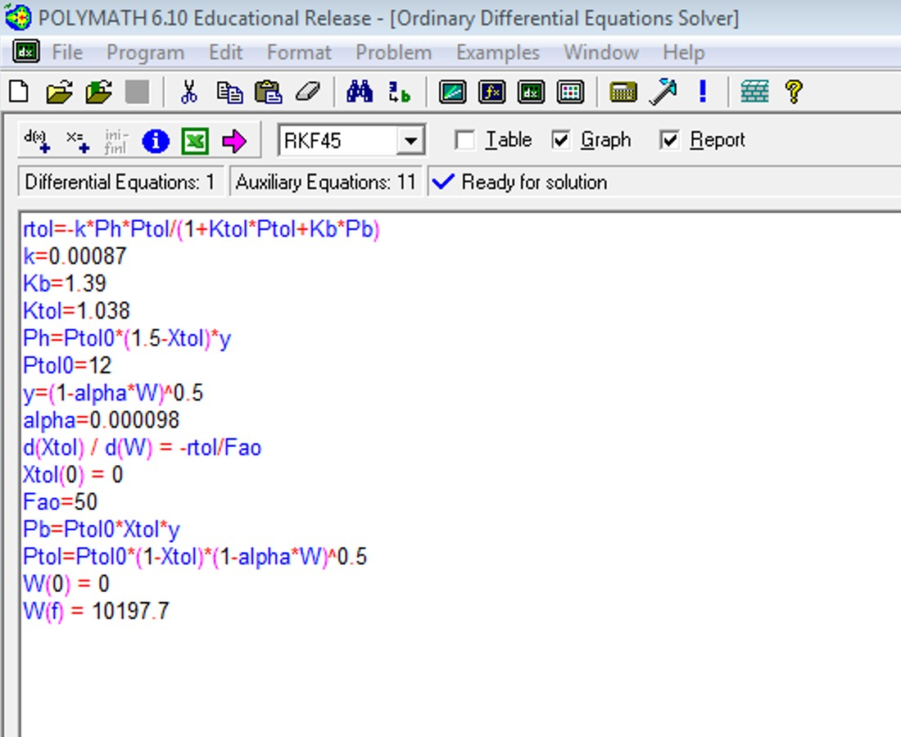

Slide 28
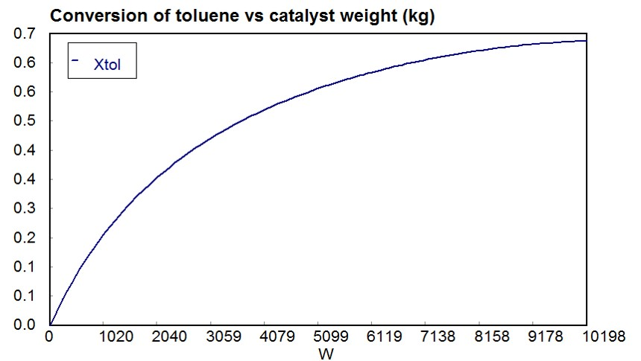

Slide 29
